Slide 1

Implementation of TCP Client-Server using Socket Programming

Slide 2

Introduction to Socket Programming
Socket Programming Fundamentals
Client-Server Communication
A client initiates a connection to a server, which listens for incoming requests. TCP (Transmission Control Protocol) guarantees that data arrives in order, without errors, and establishes a persistent connection between the two endpoints.
Sockets provide the interface for network communication between applications running on different computers. They enable processes to exchange data over a network reliably and efficiently.

Slide 3

TCP Protocol Characteristics
Connection-Oriented
Reliable Delivery
Establishes a connection before data transfer begins
Guarantees all data arrives without loss or corruption
Ordered Packets
Error Checking
Data packets arrive in the same sequence they were sent
Detects and corrects transmission errors automatically
Three-Way Handshake
Client: SYN
Server: SYN-ACK
Client: ACK

Slide 4

Client-Server Architecture
Server Role
Client Role
Listens on a specific IP address and port number
Initiates connections to the server using server's IP and port
Accepts incoming connection requests from clients
Sends requests and receives responses
Handles multiple client communications sequentially or concurrently
Can terminate connection when communication is complete
Typically short-lived connections
Remains active, awaiting new connections

Slide 5

Implementation Overview
Create Socket
Initialise TCP socket object
Bind & Listen
Server attaches to port
Connect
Client establishes link
Exchange
Send and receive data
Technology Stack
Language: Python 3
Library: Socket module
Platforms: Windows, Linux

Slide 6
Server Side Flow (TCP Socket Programming)
Create a socket
Bind the socket to IP address and Port number
Listen for incoming client connections
Accept the client connection request
Receive data from the client
Send response back to the client
Close the connection
Client Side Flow (TCP Socket Programming)
Create a socket
Connect to server using IP address and Port number
Send data to the server
Receive response from the server
Close the connection

Slide 7
Server Implementation
import socket
server = socket.socket(socket.AF_INET, socket.SOCK_STREAM)
server.bind(('127.0.0.1', 9993))
server.listen(5)
print("Server started. Waiting for client connection...")
while True:
client_socket, address = server.accept()
print(f"Connected with {address}")
data = client_socket.recv(1024).decode()
print("Received from client:", data)
if data.lower() == "exit":
client_socket.send("Goodbye!".encode())
client_socket.close()
print("Client requested exit. Closing server...")
break
# Send response back to client
response = f"Server Received: {data}"
client_socket.send(response.encode())
client_socket.close()
server.close()

Slide 8
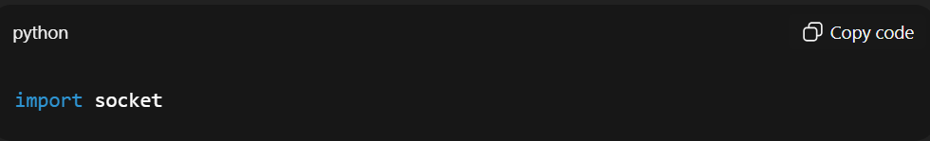
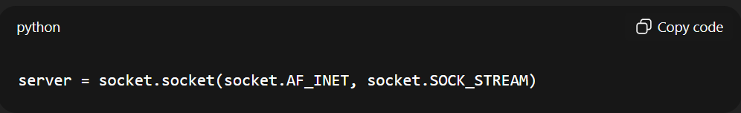
Importing the Socket Library for Network Communication:-
socket module provides networking functions
Helps create server & client communication
Creating a Server Socket
AF_INET → IPv4 addressing
SOCK_STREAM → TCP protocol
Creates a server socket object

Slide 9
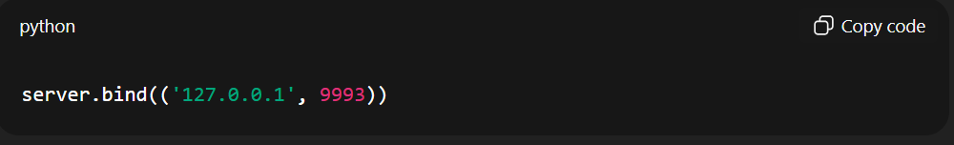
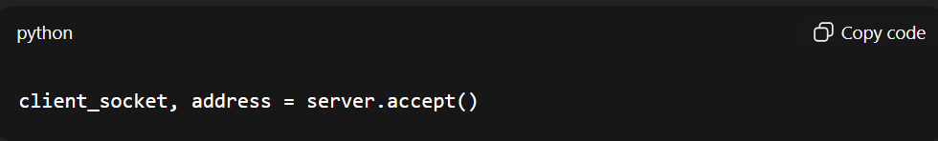
Binding the Server
Assigns the server IP & port number
127.0.0.1 → localhost (same computer)
9993 → port used for communication
Accepting Client Connection
Server accepts connection request
Returns:
client_socket → communication channel
address → client details (IP, port)

Slide 10
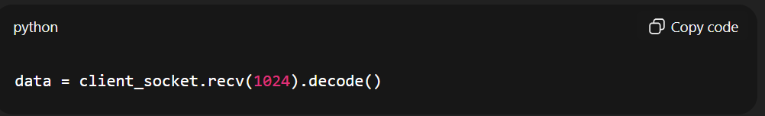
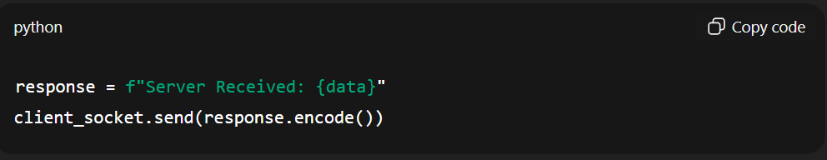
Receiving Data
Receives data sent by client
1024 → buffer size (max data per receive)
.decode() → convert bytes to string
Sending Response
Server sends confirmation message back to client
.encode() → converts string to bytes

Slide 11
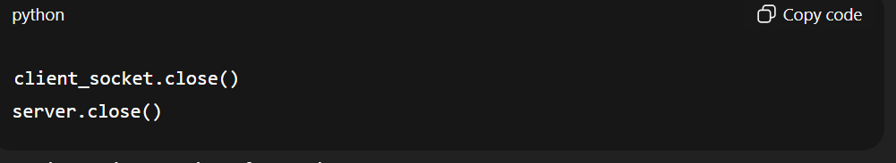
Closing Connections
Closes client socket after each response
Finally shuts server when exit request received

Slide 12
Client Implementation
import socket
import time
while True:
# Create a new socket each time
client = socket.socket(socket.AF_INET, socket.SOCK_STREAM)
# Connect to server
client.connect(('127.0.0.1', 9993))
message=input("Enter message to send to the server:")
# Send the list
client.sendall(message.encode())
# Receive response
response = client.recv(1024).decode()
print("Response from server:", response)
# Close socket
client.close()
if message.lower() == 'exit':
break
# Optional delay to avoid flooding the server

Slide 13
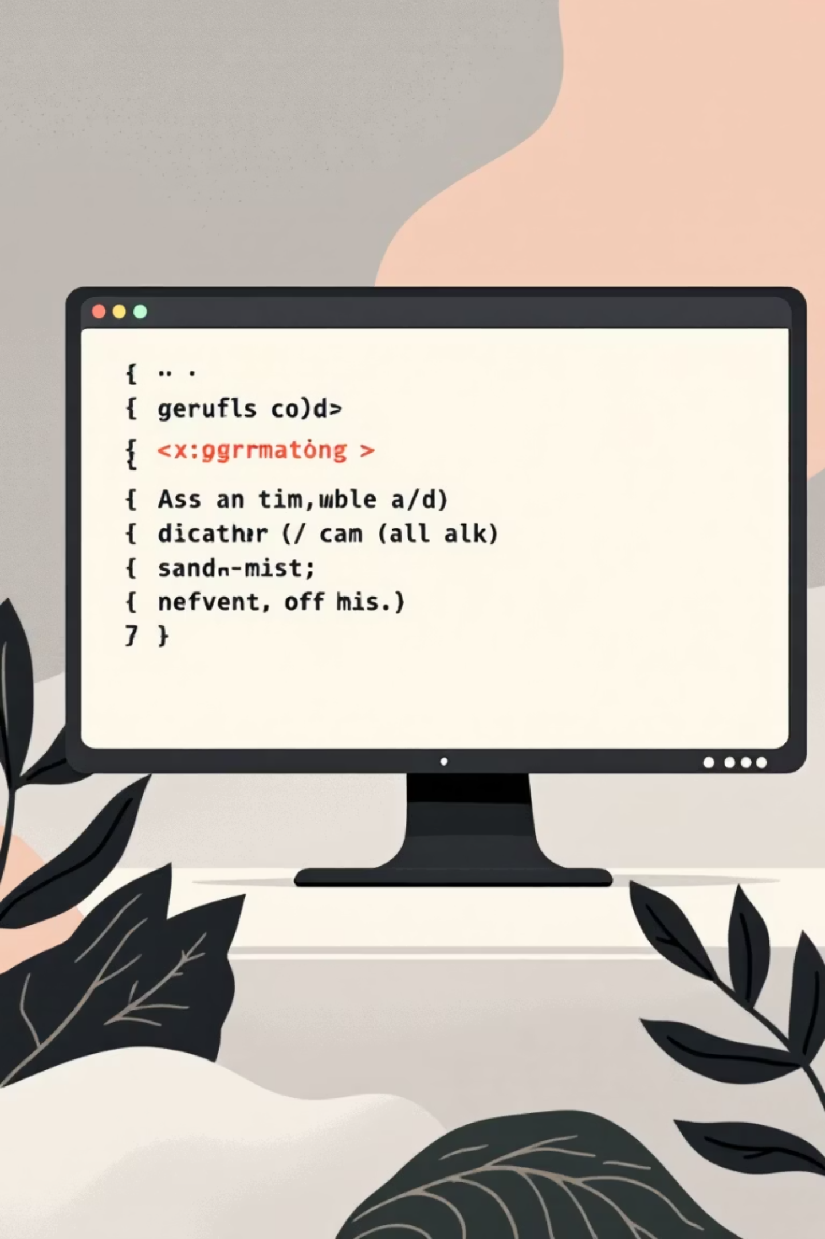
Demonstration Steps
01
Launch Server
Execute server script. Terminal displays "Listening on 127.0.0.1:12345" and waits for incoming connections
02
Run Client
Execute client script in a separate terminal. Client immediately connects to the server
03
Exchange Messages
Client sends message, server receives and displays it. Server responds with confirmation message
04
Close Connection
Client closes connection using exit command. Server returns to listening state for next client

Slide 14

Results & Output Analysis
Server Terminal Output
Client Terminal Output
Listening on 127.0.0.1:12345Connected to: ('127.0.0.1', 54321)Received: Hello from client
Enter message: Hello from clientServer: Message received
Outcome: Successful establishment of TCP connection, reliable message transmission from client to server, and acknowledgement response demonstrates complete implementation of the socket programming protocol.

Slide 15










Conclusion & Future Applications
Key Takeaways
TCP ensures reliable, ordered, and error-free communication between networked applications
Socket programming provides the foundation for all network-based software applications
Python's socket library simplifies implementation of complex networking protocols
Real-World Applications
File Transfer
Chat Applications
Web Servers
Database Systems
Online Gaming
Future Enhancements
Multi-client concurrent handling using threading, secure communication with encryption, file sharing capabilities, and graphical user interfaces for improved usability.

